Slide 1


Baskerville
Challenge 3 Image Segmentation via Deep Learning using TensorFlow and Keras

Slide 2

Baskerville Challenge 3
WHAT THIS CHALLENGE IS
Neural Networks for LV Identification
Discussion/Demonstration of Image Segmentation using Deep
Learning
Transposed Convolutional Neural Networks
Hands
-
on exercises using TensorFlow for CNN training and
evaluation of Image Segmentation workflow
Modern Deep Learning Frameworks
Get practice using TensorFlow 2 and the
KerasAPI

Slide 3
Baskerville Challenge 3 Learning objectives
Define image segmentation
Describe image segmentation architectures
Use Image segmentation

Slide 4

Neural Networks Biological Inspiration

Slide 5
Neural Networks Architecture
Input Layer
Hidden Layer
Output Layer
Neuron
Synapse

Slide 6
Neural Networks Introduction
Say you're helping a friend who wants to buy a house. She was quoted $400,000 for a 2000 sq ft house (185 meters). Is this a good price or not?
Price houses in that same neighbourhood
Area (sq ft) (x) | Price (y)
2,104 | 399,900
1,600 | 329,900
2,400 | 369,000
Alammar, J (2018). The Illustrated Transformer [Blog post]. Retrieved from https://jalammar.github.io/illustrated-transformer/

Slide 7
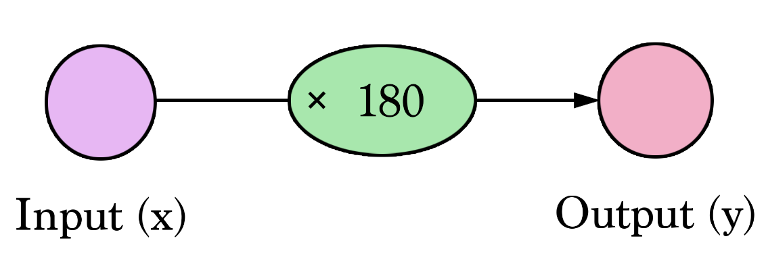
Neural Networks Introduction
First idea would be to get the average price per sq ft. That comes to $180 per sq ft.
Diagrams like this show you the structure of the network and how it calculates a prediction. The calculation starts from the input node at the left. The input value flows to the right. It gets multiplied by the weight and the result becomes our output.
Alammar, J (2018). The Illustrated Transformer [Blog post]. Retrieved from https://jalammar.github.io/illustrated-transformer/

Slide 8

Neural Networks Introduction
Multiplying 2,000 sq ft by 180 gives us $360,000. That's all there is to it at this level. Calculating the prediction is simple multiplication. But before that, we needed to think about the weight we'll be multiplying by. Here we started with an average.
Finding the weight is our "training" stage. So whenever you hear of someone "training" a neural network, it just means finding the weights we use to calculate the prediction.
Alammar, J (2018). The Illustrated Transformer [Blog post]. Retrieved from https://jalammar.github.io/illustrated-transformer/

Slide 9
Neural Networks Introduction
This is a form of prediction. This is a simple predictive model that takes an input, does a calculation, and gives an output (since the output can be of continuous values, the technical name for what we have would be a “regression model”)
Alammar, J (2018). The Illustrated Transformer [Blog post]. Retrieved from https://jalammar.github.io/illustrated-transformer/

Slide 10
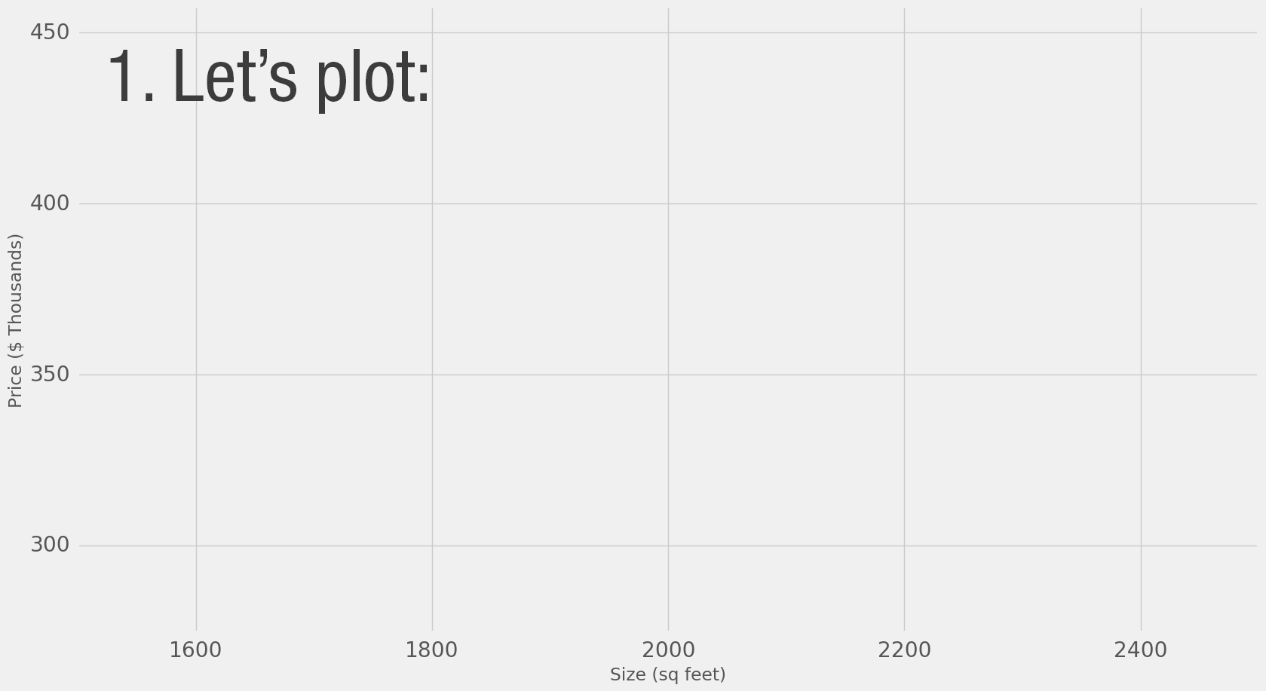
Neural Networks Introduction
Alammar, J (2018). The Illustrated Transformer [Blog post]. Retrieved from https://jalammar.github.io/illustrated-transformer/

Slide 11
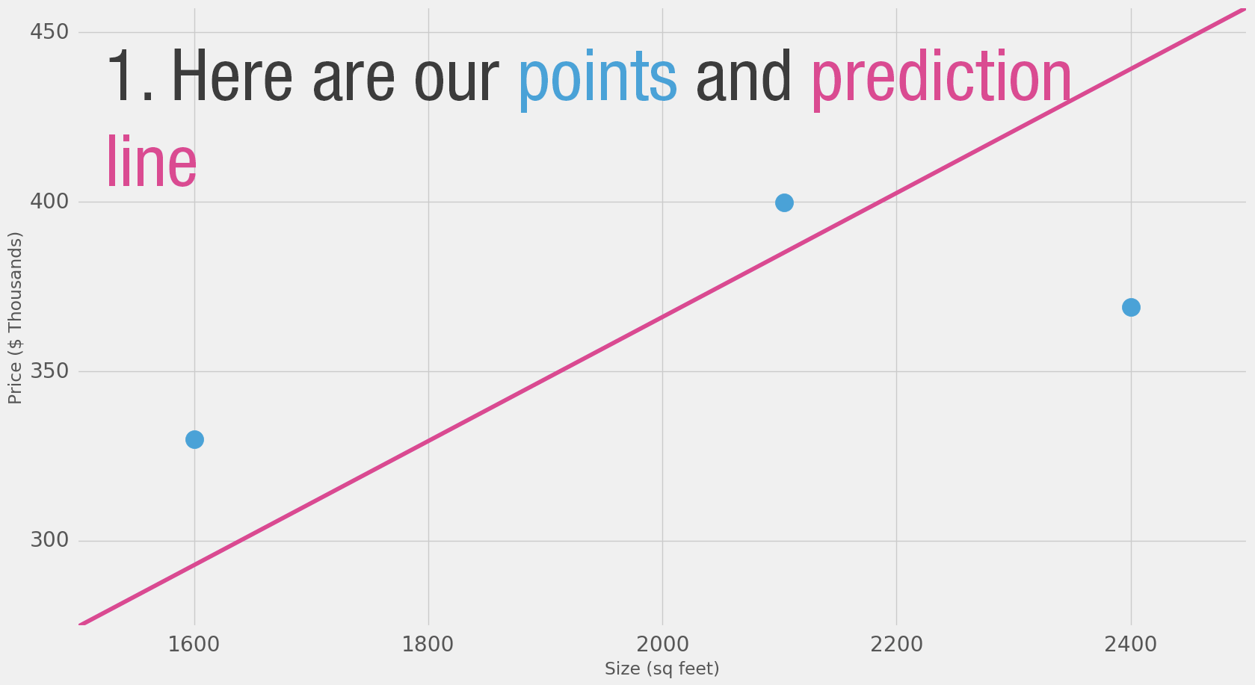
Neural Networks Introduction
Alammar, J (2018). The Illustrated Transformer [Blog post]. Retrieved from https://jalammar.github.io/illustrated-transformer/

Slide 12
Neural Networks Introduction
Here we can see the actual price value, the predicted price value, and the difference between them. Then we’ll need to average these differences so we have a number that tells us how much error there is in this prediction model. The problem is, the 3rd row has -63 as its value. We have to deal with this negative value if we want to use the difference between the prediction and price as our error measuring stick. That’s one reason why we introduce an additional column that shows the error squared, thus getting rid of the negative value.
Area (x) | Price ($1000) (y_) | Prediction (y) | y_-y | (y_-y)²
2,104 | 399.9 | 379 | 21 | 449
1,600 | 329.9 | 288 | 42 | 1756
2,400 | 369 | 432 | -63 | 3969
 |  | Average: |  | 2,058
Alammar, J (2018). The Illustrated Transformer [Blog post]. Retrieved from https://jalammar.github.io/illustrated-transformer/

Slide 13
Neural Networks Loss function
This is now our definition of doing better – a better model is one that has less error.
Error is measured as the average of the errors for each point in our data set.
For each point, the error is measured by the difference between the actual value and the predicted value, raised to the power of 2.
This is called Mean Square Error. Using it as a guide to train our model makes it our loss function (also, cost function).
Alammar, J (2018). The Illustrated Transformer [Blog post]. Retrieved from https://jalammar.github.io/illustrated-transformer/

Slide 14
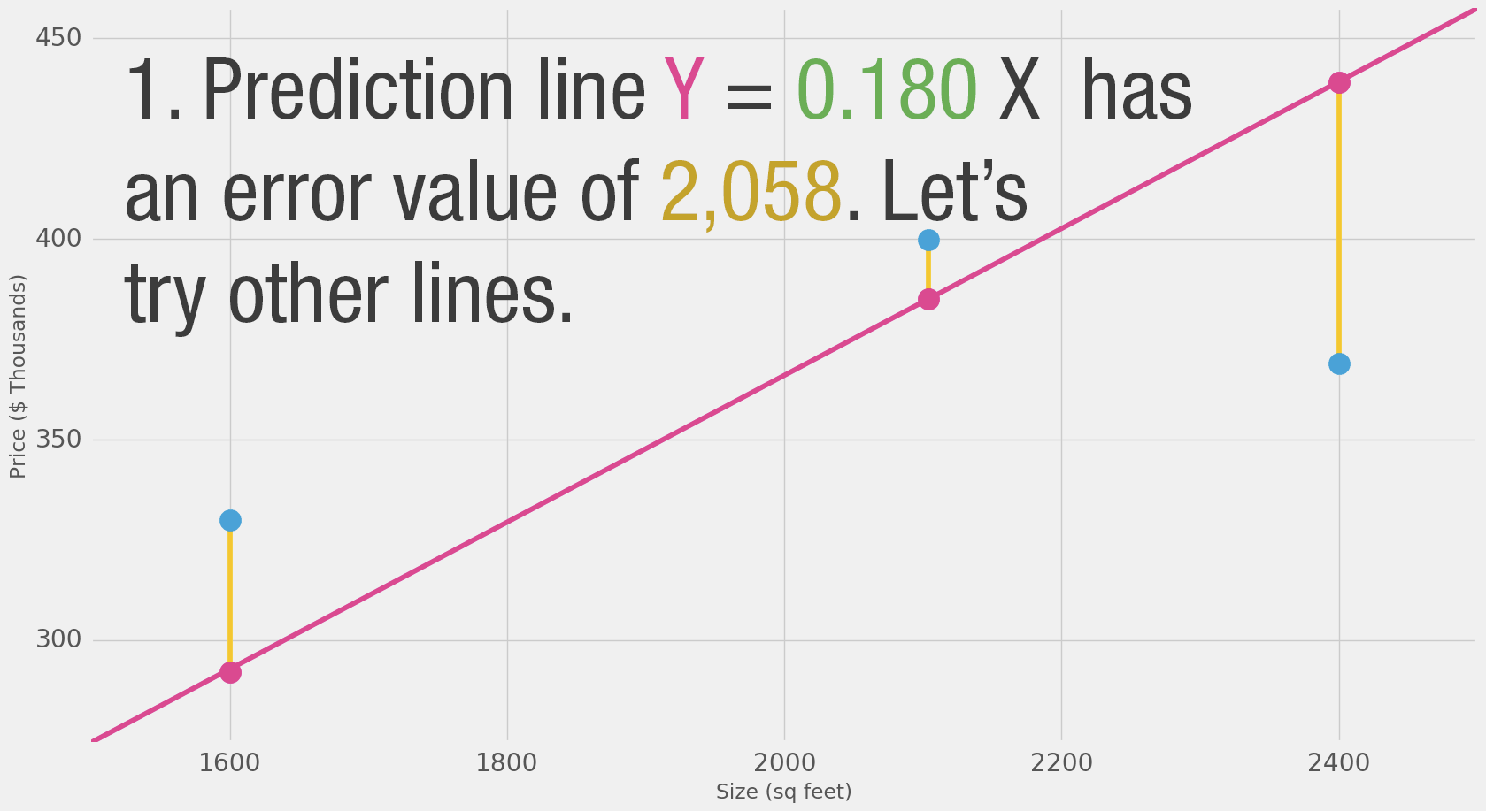
Neural Networks Introduction
Alammar, J (2018). The Illustrated Transformer [Blog post]. Retrieved from https://jalammar.github.io/illustrated-transformer/

Slide 15
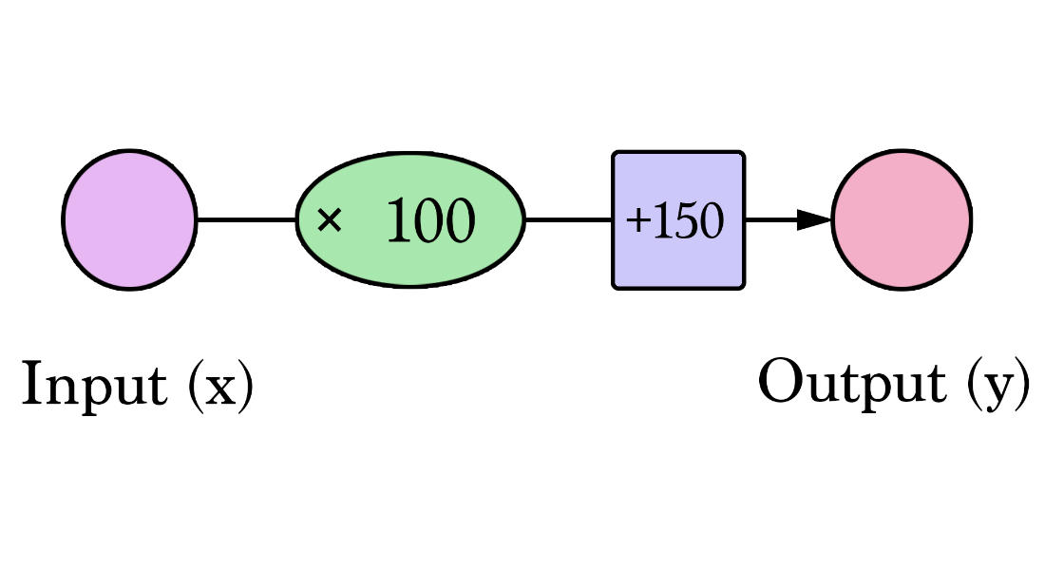
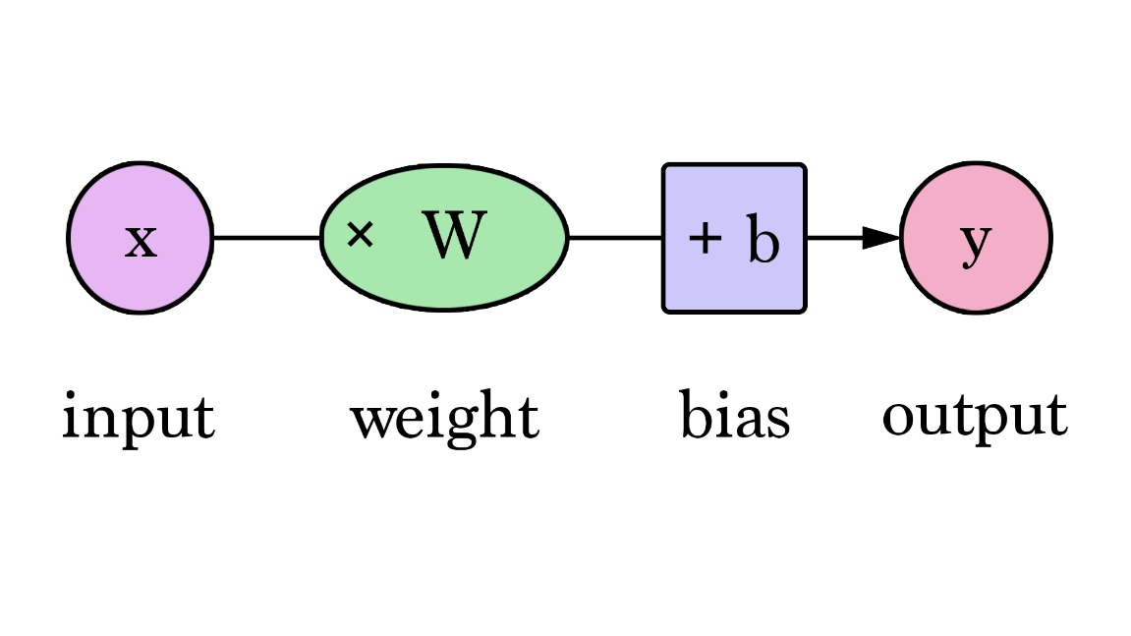
Neural Networks Introduction
Our lines can better approximate our values now that we have this b value added to the line formula. In this context, we call it a “bias”. This makes our neural network look like this:
N or
Alammar, J (2018). The Illustrated Transformer [Blog post]. Retrieved from https://jalammar.github.io/illustrated-transformer/

Slide 16
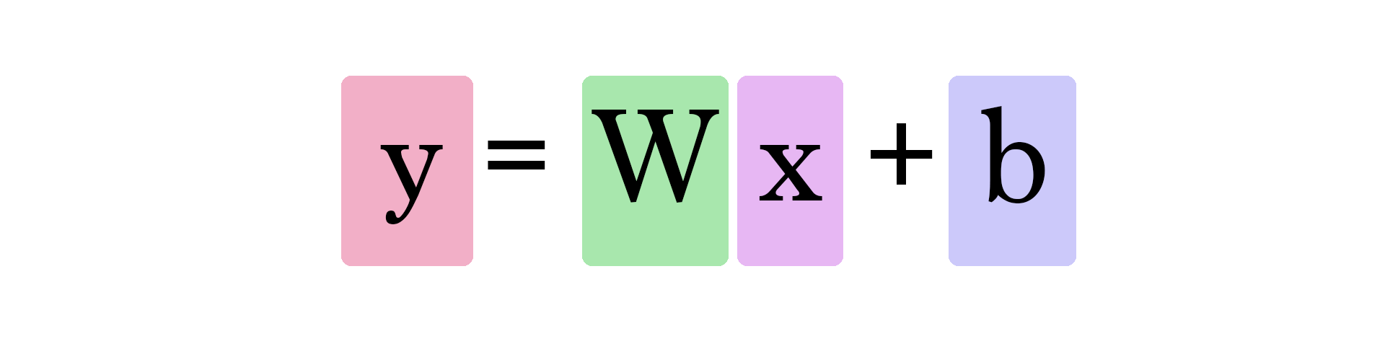
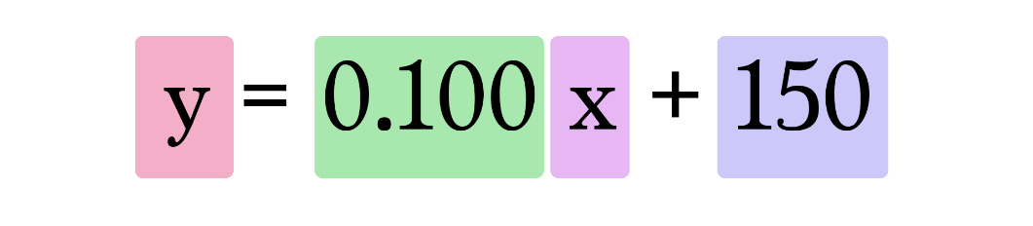
Neural Networks Introduction
In this chart, W and b are values we find during the training process. X is the input we plug into the formula (area in sq ft in our example). Y is the predicted price.
Calculating a prediction now uses this formula:
Alammar, J (2018). The Illustrated Transformer [Blog post]. Retrieved from https://jalammar.github.io/illustrated-transformer/

Slide 17
Neural Networks Introduction
Factoring in the number of bathrooms
Gives Dataset:
Area (sq ft) (x1) | Bathrooms (x2) | Price (y)
2,104 | 3 | 399,900
1,600 | 3 | 329,900
2,400 | 3 | 369,000
1,416 | 2 | 232,000
3,000 | 4 | 539,900
1,985 | 4 | 299,900
1,534 | 3 | 314,900
1,427 | 3 | 198,999
1,380 | 3 | 212,000
1,494 | 3 | 242,500
Alammar, J (2018). The Illustrated Transformer [Blog post]. Retrieved from https://jalammar.github.io/illustrated-transformer/

Slide 18
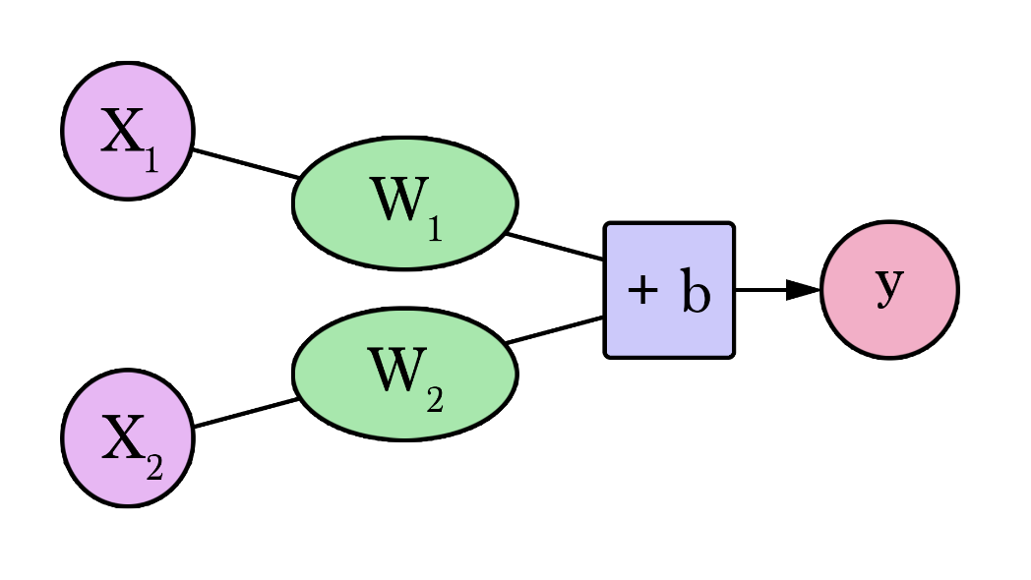
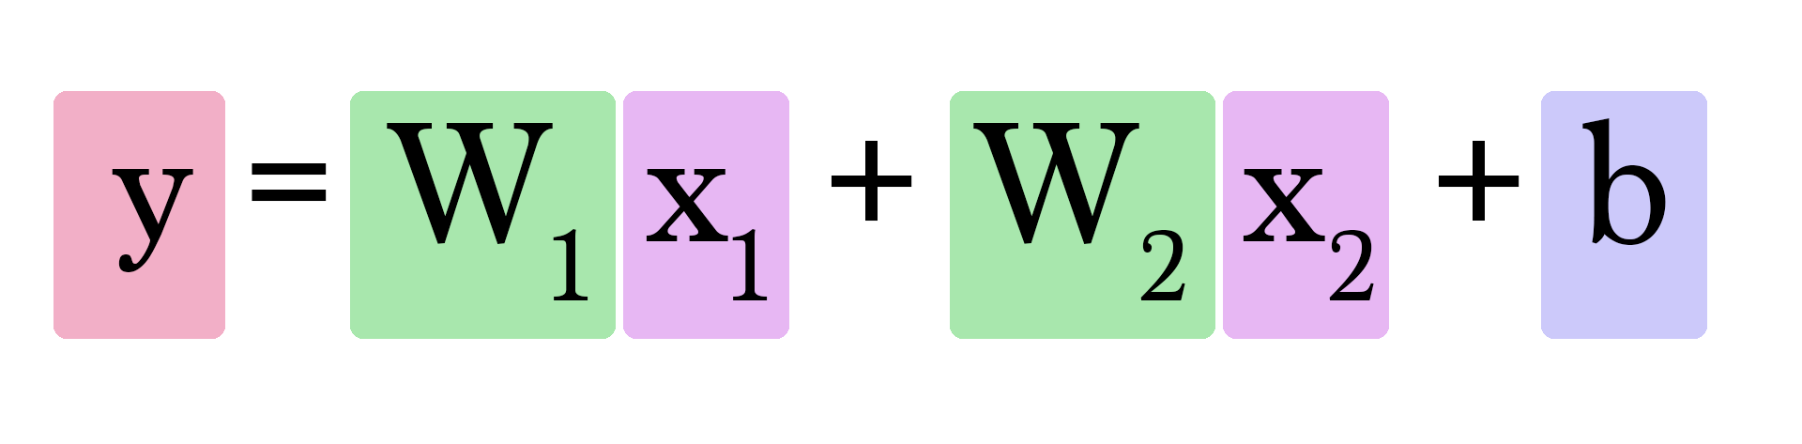
Neural Networks Introduction
NN representation and Equation
Alammar, J (2018). The Illustrated Transformer [Blog post]. Retrieved from https://jalammar.github.io/illustrated-transformer/

Slide 19
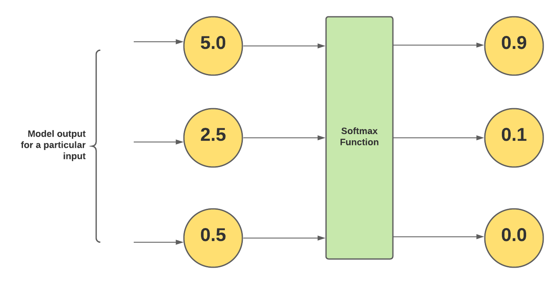
Neural Networks Softmax
It could be understood that the output of the softmax function maps to a [0, 1] range. And, it maps outputs in a way that the total sum of all the output values is 1. Thus, it could be said that the output of the softmax function is a probability distribution.
Notice that the softmax outputs are less than 1. And, the outputs of the softmax function sum up to 1.

Slide 20
Neural Networks Max Pooling
Since convolutional layers can produce a large number of output values, it is often useful to simplify the outputs
Max-pooling extracts the largest values in a layer
Max-pooling is defined with a kernel size (in this example, the kernel size is 2)
1 | 0 | 2 | 2
1 | 3 | 0 | 1
3 | 1 | 4 | 1
2 | 0 | 2 | 1
2x2 Max Pooling
3 | 2
3 | 4

Slide 21
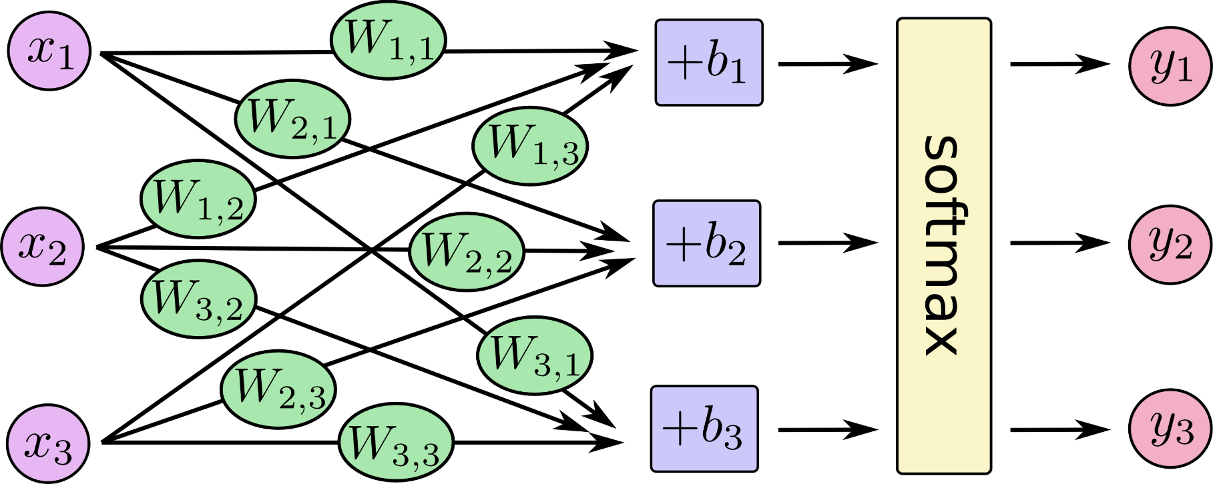
Neural Networks Introduction
More Features!
Alammar, J (2018). The Illustrated Transformer [Blog post]. Retrieved from https://jalammar.github.io/illustrated-transformer/

Slide 22
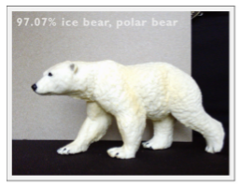
Baskerville Challenge 3 Images
Objective:
Recognize the main subject in the image and
assign a label to the image
Input:
Image
Predefined set of labels (categories/classes)
Output:
Predicted class
BEAR
(single object)

Slide 23
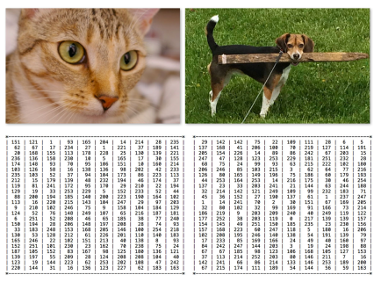
Baskerville Challenge 3 The Semantic Gap

Slide 24
Baskerville Challenge 3 The Semantic Gap
We might describe the image as follows:
Spatial: The seagull is at the top of the image and the trees are at the bottom.
Color: The seagull is grey with black markings on the head, the trees are darker green.
Texture: The seagull has a relatively uniform pattern, while the trees are very tall with a trunk and branches.

Slide 25
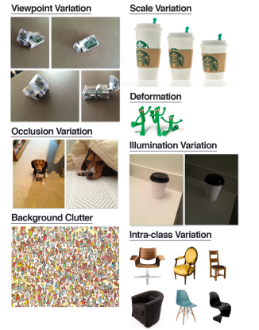
Baskerville Challenge 3 Image Challenges
When developing an image classification system, it's important to know that object can appear at varying viewpoints, lighting conditions, occlusions, scale, etc.

Slide 26
Definition - What is Image Segmentation?
Segmentation:
Partitioning image into multiple segments.
Segment:
Set of pixels that share certain characteristics => can share the same label => per-pixel labelling
Motivation:
Simplifying image => easier to analyze it and understand complete scene (e.g. in self-driving vehicles, medical imaging etc...)
Types:
Semantic
Instance

Slide 27
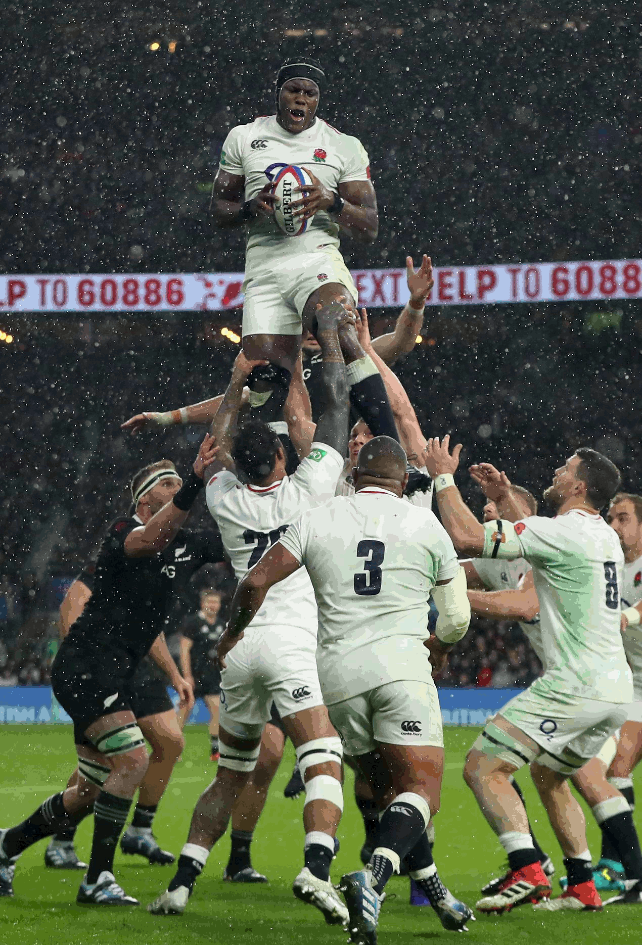
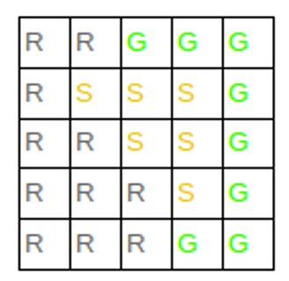
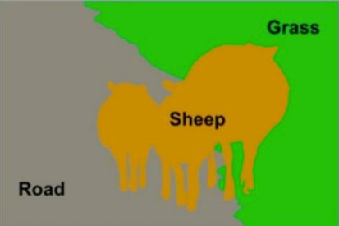
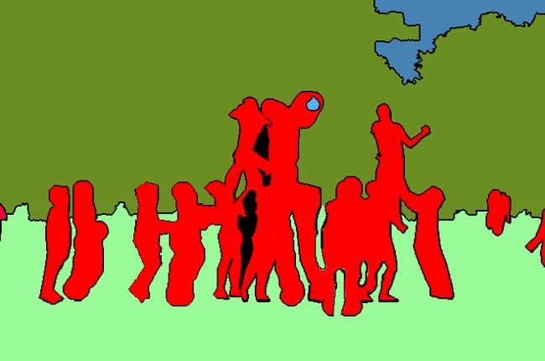
Definition - What is Semantic Segmentation?
Labelling each pixel of an image with a corresponding class. It's also called "Pixel-labeling".
Crowd
People

Slide 28
Definition - Semantic Segmentation
Objective:
Classify all pixels
Don't differentiate instances.
Image
Categories
Output:
Labeled pixels
Category pixels painted with same colour
Shortcoming:
Instances not differentiated
ROAD, SHEEP, GRASS

Slide 29
Definition - Semantic Segmentation
Methods:
Sliding Window + Image classification (convolutional neural network [CNN])
classification result for each crop is assigned to central pixel of that crop
need crop for each pixel => computationally expensive 👎
Fully convolutional neural network [CNN]
Input → [Conv] → Output
If conv layers keep spatial size (so the output image has same resolution as the input image) => computationally expensive 👎
To reduce number of parameters (but keep the input resolution at the output image): 👍
Input → [Conv → Downsampling] → [Upsampling → Deconv] → Output
Training:
Data: Each pixel must be labeled (expensive task).
Loss function: cross-entropy computed for each pixel and then averaged.

Slide 30
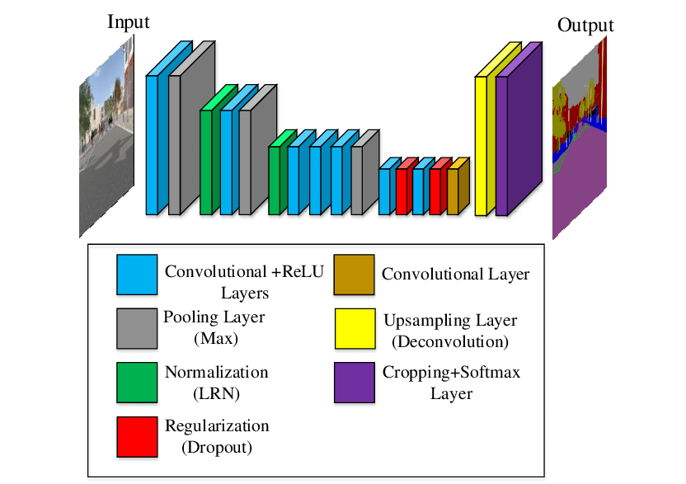
Fully Convolutional Networks for Semantic Segmentation
https://arxiv.org/pdf/1411.4038.pdf
FCN variants using image classification backbones:
FCN-Alexnet
FCN-Googlenet
FCC-VGG16/19
FCN-ResNet18/50/101
FCN-Alexnet
Alexnet
FCN

Slide 31
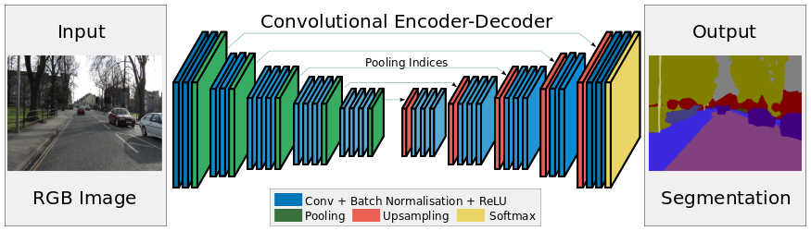
Segnet
SegNet: A Deep Convolutional Encoder-Decoder Architecture for Image Segmentation

Slide 32
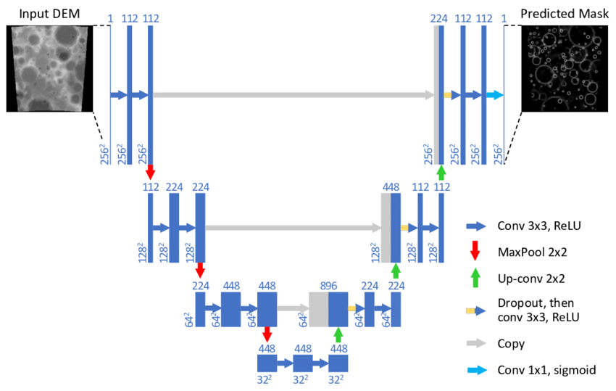
U-net
U-Net: Convolutional Networks for Biomedical Image Segmentation

Slide 33
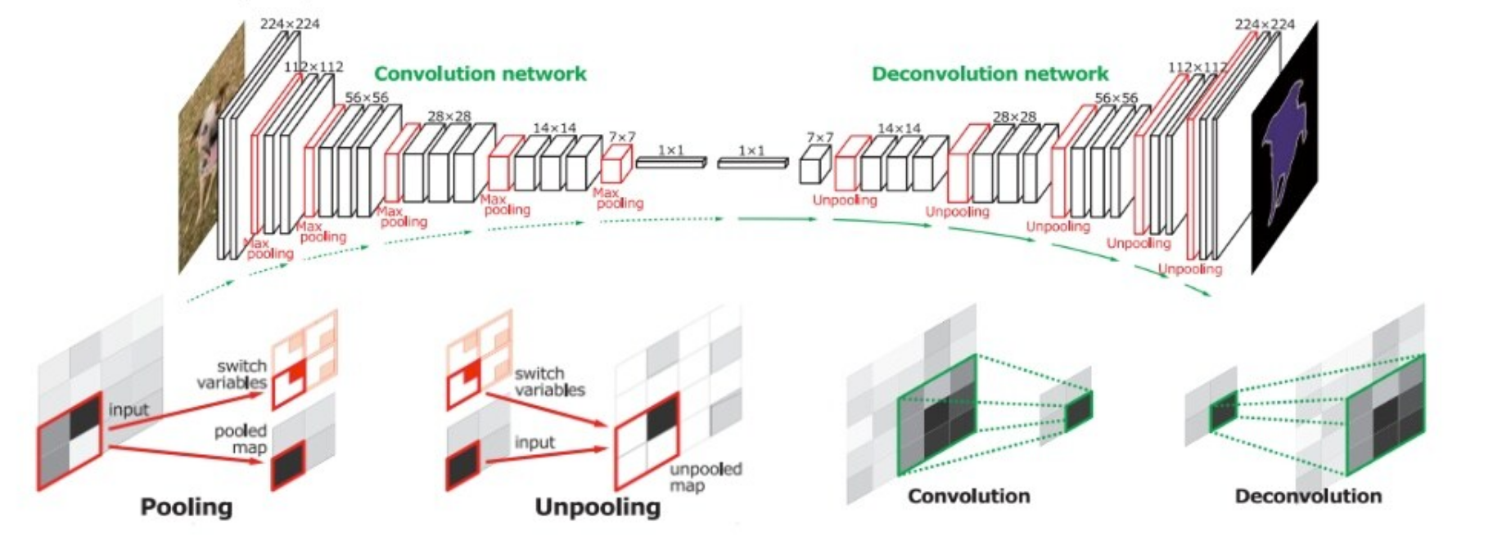
Semantic Segmentation
Hyeonwoo Noh et al: Learning Deconvolution Network for Semantic Segmentation (2015)

Slide 34
What Is TENSORFLOW? (Created by Google, tensorflow.org)
“Open source software library for machine intelligence”
Available on GitHub
Flexibility—express your computation as a data flow graph
If you can express it in TF syntax, you can run it
Portability—CPUs and GPUs, workstation, server, mobile
Language options—Python, C++, Go, Java
Performance—Tuned for performance on CPUs and GPUs
Assign tasks to different hardware devices
Uses CUDNN

Slide 35
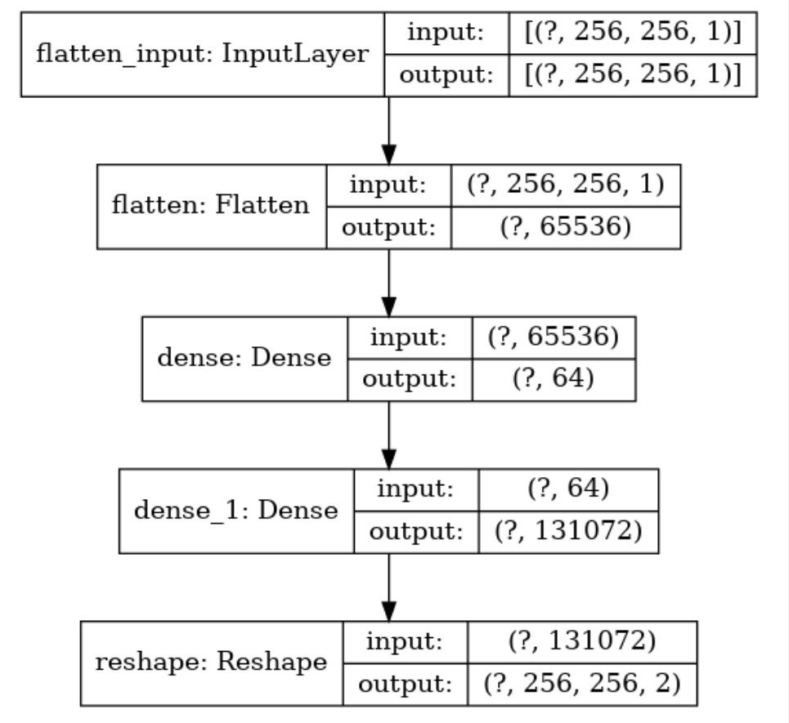
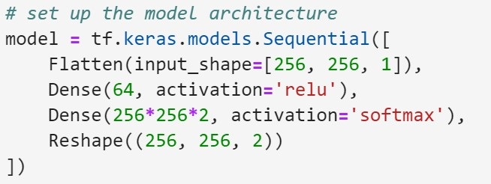
What Is Keras? (Created by keras.io)
•
“
Keras is a deep learning API written in
Python, running on top of the machine
learning platform TensorFlow”
•
Comes preinstalled with TensorFlow 2

Slide 36
Keras Deep Learning Workflow
1 | Prepare the Data TFRecords
2 | Build the Keras Model
3 | Train the Model
4 | Evaluate the Model (DICE, TensorBoard)

Slide 37
Start the Lab!

Slide 38
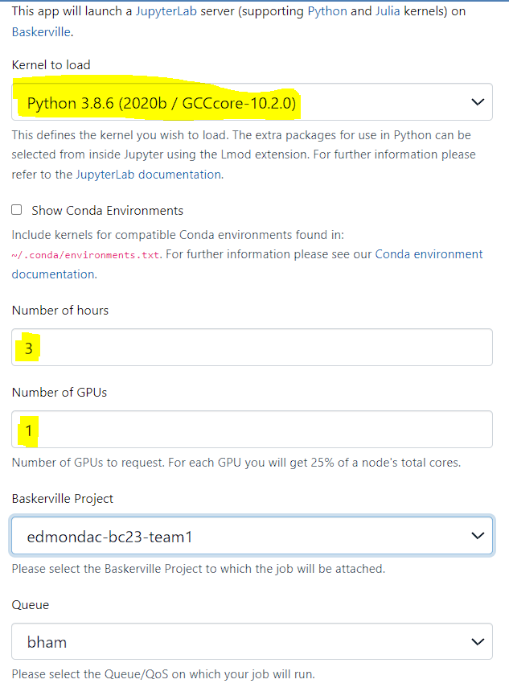

Slide 39
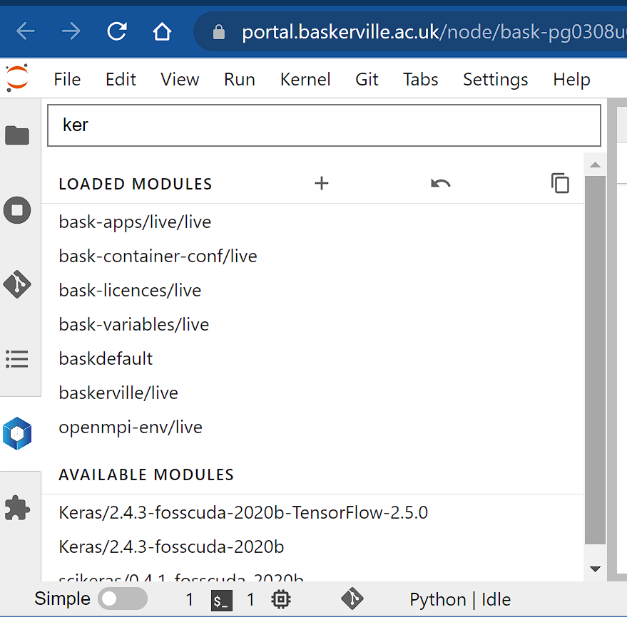
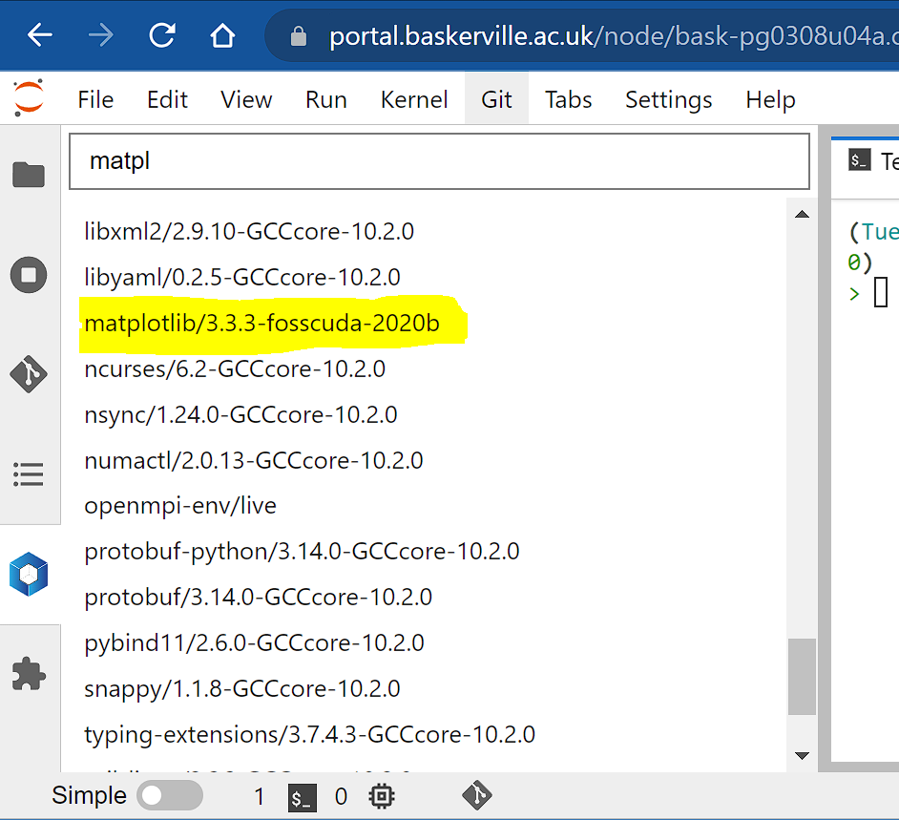
Start the Lab!

Slide 40
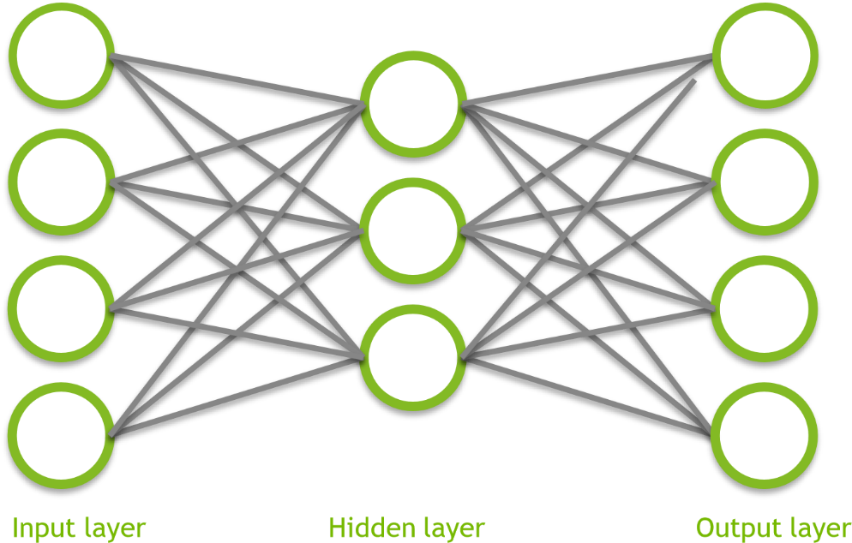
Lab Task 1
Train and test a fully-connected neural network with one hidden layer
For the loss computation we’ll use TF built-in sparse_softmax_cross_entropy_with_logits
Computes softmax of the inference output then cross entropy against the correct labels
(256 x 256) pixels 512 256 x 256 x 2
Ensure things are working properly!

Slide 41


Lab Task 1
1
2
3
4
5
1
2
3
4
5

Slide 42
Lab Task 2 Convolution Layers
Convolution layers
Previous example focused on each input pixel
What if features encompass multiple input pixels?
Can use convolutions to capture larger receptive fields
Pooling layers
Essentially a down-sampling method retaining information while eliminating some computational complexity

Slide 43
Lab Task 2 Convolution Layers
2
D Convolution
.0
.8
.6
.7
.5
.3
.4
.0
.9
.0
2
D Transposed
Convolution

Slide 44
Lab Task 2 Convolution Layers
2
D Convolution
.0
.8
.6
X 0.1
X 0.2
X 0.1
.7
.5
.3
.4
X 0.0
X 0.2
X 0.0
.0
.9
.0
X 0.2
X 0.1
X 0.1

Slide 45
Lab Task 2 Convolution Layers
.0
.8
.6
X 0.0
X 2.0
X 1.5
.7
.5
.3
.4
X 1.7
X 1.2
X 0.7
.0
.9
.0
X 0.0
X 2.2
X 0.0
2
D Transposed
Convolution

Slide 46
Lab Task 2 Convolution Layers
Max Pooling
.0
.8
.6
.7
.5
.3
.9
.0
.9
.0
Finish the CNN, replace “FIXME”

Slide 47
Lab Task 2 Max Pooling Layer
Max Pooling
.0
.8
.6
.7
.5
.3
.9
.0
.9
.0
Finish the CNN, replace “FIXME”

Slide 48
Lab Task 2 Conv/Max Pooling Layer
You need to figure out the dimensions
Convolution1, 5x5 kernel, stride 2; Maxpooling1, 2x2 window, stride 2
Convolution2, 5x5 kernel, stride 2; Maxpooling2, 2x2 window, stride 2
Convolution3, 3x3 kernel, stride 1; Convolution4, 3x3 kernel, stride 1
Score_classes, 1x1 kernel, stride 1; Upscore (DeConv), 31x31 kernel, stride 16
Optional / Time Permitting: Experiment with num_epochs

Slide 49
Lab Task 3 The DICE Metric
Metric to compare the similarity of two samples:
2 Anl
______________________________
An + Al
Where:
A_{n} is the area of the contour predicted by the network
A_{l} is the area of the contour from the label
A_{nl} is the intersection of the two
The area of the contour that is predicted correctly by the network
1.0 means perfect score.

Slide 50
Lab Task 3 The DICE Metric
2 x The Purple Area
Area of the Red Circle + Area of the Blue Circle

Slide 51
Lab Task 3 Parameter Search
learning_rate: initial learning rate
decay_rate: the rate that the initial learning rate decays
e.g., 1.0 is no decay, 0.5 means cut the decay rate in half each number of (decay) steps
decay_steps: number of steps to execute before changing learning rate
num_epochs: number of times to cycle through the input data
batch_size: keep at 1 for now
Experiment with learning_rate, decay_rate, decay_steps, num_epoch
Record the parameters that give you the best Dice score

Slide 52
Lab Task 3 Parameter Search
learning_rate: initial learning rate
decay_rate: the rate that the initial learning rate decays
e.g., 1.0 is no decay, 0.5 means cut the decay rate in half each number of (decay) steps
decay_steps: number of steps to execute before changing learning rate
num_epochs: number of times to cycle through the input data
batch_size: keep at 1 for now
Experiment with learning_rate, decay_rate, decay_steps, num_epoch
Record the parameters that give you the best Dice score

Slide 53
Quiz Vision Deep Neural Networks (DNNs)
Q1. What is the most crucial step in image classification to identify the features of a dog?
A. Try to classify a photograph of a dog
B. Use dog images to train AI
C. Use pre-trained AI model
D. Use images of different animals to teach the AI

Slide 54
Quiz Vision Deep Neural Networks (DNNs)
Q2. A highly well-trained model has been trained to detect features of a dog. The model is also used to detect a skinny hairless dog which looks like a chicken. What might be wrong that the hairless dog is not classified at all?
A. Image quality is poor
B. There were no photos of hairless dogs in the training data
C. A weakness exists in computer vision
D. There weren't enough dog photos in the training data

Slide 55
Quiz Vision Deep Neural Networks (DNNs)
Q3. The order of channels in PNG
A. GRB
B. BRG
C. BGR
D. R​GB

Slide 56
Quiz Vision Deep Neural Networks (DNNs)
Q4. What type of image operation can ​convolution perform?
A. Edge detection
B. Sharpening
C. Blurring
D. All of the above

Slide 57
Quiz Vision Deep Neural Networks (DNNs)
Q5. T​he height of the image is the:
A. N​umber of columns
B. N​umber of rows
C. N​umber of pixels
D. N​one of the above

Slide 58
Quiz Vision Deep Neural Networks (DNNs)
Q6. How many colour channels does a Grayscale image have ​?
A. 1
B. 2
C. 3
D. 0​

Slide 59
Quiz Vision Deep Neural Networks (DNNs)
Q7. You train a CNN and obtain an accuracy of 100% on the training data and 50% on the validation data. This is an example of:
A. Overfitting
B. Underfitting
C. A good model
D. None of Above

Slide 60
Quiz Vision Deep Neural Networks (DNNs)
Q8 Which of the following are types of CNN architecture? Choose all that apply:
A. RavNe
B. VGGNet
C. AlexNet
D. JoNet

Slide 61
Quiz Vision Deep Neural Networks (DNNs)
Q9. What makes a neural network a deep neural network?
A. Having one hidden layer
B. Having no hidden layer
C. An overfitting model
D. Having more than one hidden layer

Slide 62
Quiz Vision Deep Neural Networks (DNNs)
Q10. A lot of times, we don’t have the time and resources to build our own model, so we use pre-trained CNN’s to speed up the process. This is best described as..
A. Transfer learning
B. Deep learning
C. State Vector Machine
D. AlexNet

Slide 63
Challenge Marking (DNNs)
Points 20
Showed Understanding of Tensorflow Concepts through notebook experiment on params 2
Fixed README part of ipynotebook 12
Correct QUIZ answers in Text file 5
Team with Best Dice Score 1

